Slide 1
Workbook & Worksheet Object
Notes:
https://www.excel-easy.com/vba/create-a-macro.html

Slide 2
Table of Contents
Object Hierarchy
Collections
Properties & Methods
LOOP through books and sheets

Slide 3
Object Hierarchy
Add a new module
In Excel VBA, an object can contain another object, and that object can contain another object, etc. In other words, Excel VBA programming involves working with an object hierarchy. This probably sounds quite confusing, but we will make it clear.
The mother of all objects is Excel itself. We call it the Application object. The application object contains other objects. For example, the Workbook object (Excel file). This can be any workbook you have created. The Workbook object contains other objects, such as the Worksheet object. The Worksheet object contains other objects, such as the Range object.

Slide 4
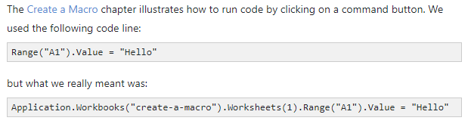
Object Hierarchy
Dot Notation
Note: the objects are connected with a dot. Fortunately, we do not have to add a code line this way. In the previous lesson the reason we do not need the dot notation is because we are working on the same worksheet. Be aware that if you want to change things on different worksheets, you have to include the Worksheet object. Read on.

Slide 5
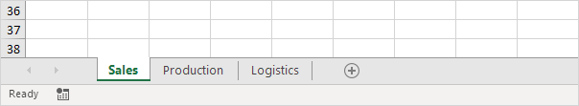
Collections
You may have noticed that Workbooks and Worksheets are both plural. That is because they are collections. The Workbooks collection contains all the Workbook objects that are currently open. The Worksheets collection contains all the Worksheet objects in a workbook.

Slide 6
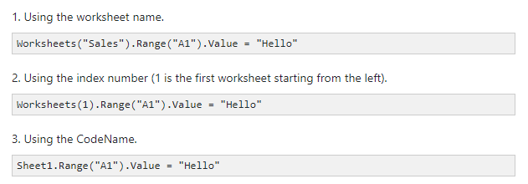
Collections
You can refer to a member of the collection, for example, a single Worksheet object, in three ways.

Slide 7
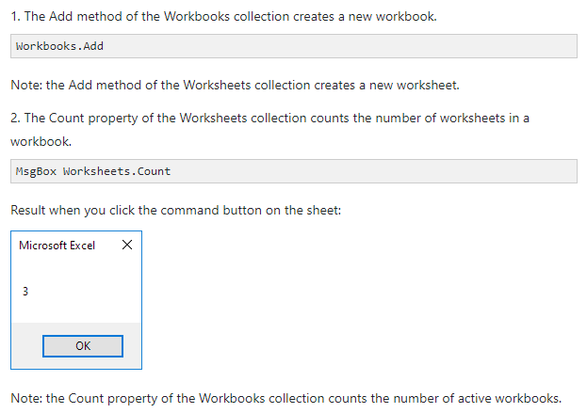
Properties & Methods
Now let's take a look at some properties and methods of the Workbooks and Worksheets collection. Properties are something which an collection has (they describe the collection), while methods do something (they perform an action with an collection).
Place a command button on your worksheet and add the code lines:

Slide 8
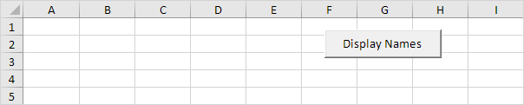
LOOP through books and sheets
Below we will look at a program in Excel VBA that loops through all open workbooks and worksheets, and displays all the names.
Situation:

Slide 9
LOOP through books and sheets
Below we will look at a program in Excel VBA that loops through all open workbooks and worksheets, and displays all the names.
Situation:
https://www.excel-easy.com/vba/examples/loop-through-books-sheets.html

Slide 10
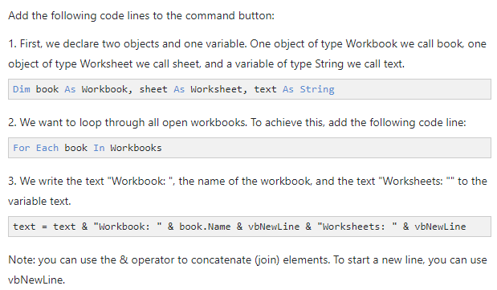
LOOP through books and sheets

Slide 11
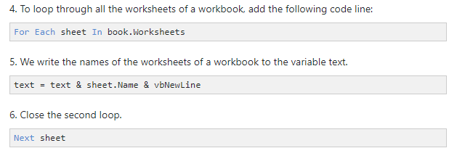
LOOP through books and sheets

Slide 12
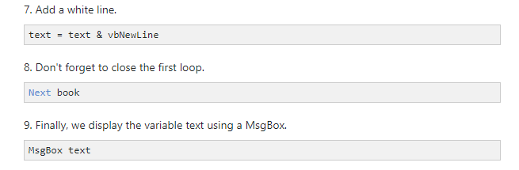
LOOP through books and sheets

Slide 13
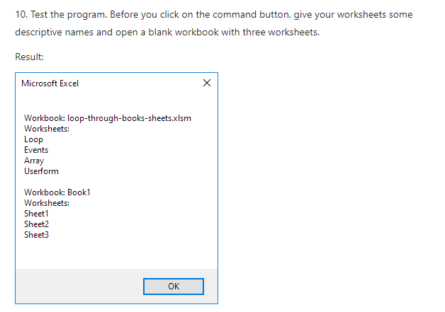
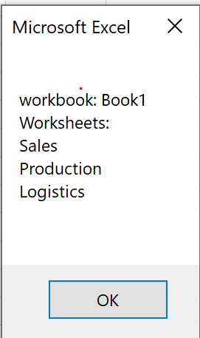
LOOP through books and sheets

